Slide 1
Atomic Absorption Spectroscopy

Slide 2

In this Smart Lesson you will learn about an analytical technique called atomic absorption spectroscopy (AAS). You will learn how the process works, what it is used for, and will look at some examples of how the technique is used.

Slide 3
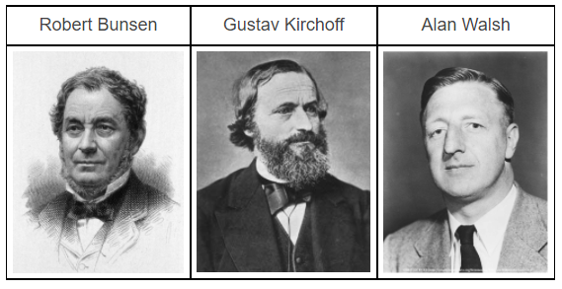
The technique of atomic absorption spectroscopy (AAS) was first used in the late 19th century by Robert Bunsen and Gustav Kirchhoff in Germany. These scientists were studying the effects of heating substances. Robert Bunsen developed a new, improved method of heating, which we now call the bunsen burner. They noticed that when substances were heated, low density gases gave off an emission spectrum characteristic of the elements present. They also discovered that vaporised substances also absorbed specific wavelengths of light, dependent on the elements present, known as the absorption spectrum.
The technique was refined in the 1950s by Sir Alan Walsh's team at the CSIRO in Melbourne. They improved the vaporisation process, using an electrothermal method involving graphite tubes which is still used today.

Slide 4
Atomic absorption spectroscopy (AAS) is used to detect cations, so can be used to measure the concentration of metals in:
• | biological tissues, such as blood and urine.
• | water, testing for contamination such as industrial waste.
• | air, such as testing for lead pollution.
• | soil, testing for contaminants.
• | food, checking for contamination due to pesticides and herbicides.
• | pharmaceuticals, testing for purity of drugs, which may contain the remains of catalysts in the products.
• | alloys, testing the purity.

Slide 5
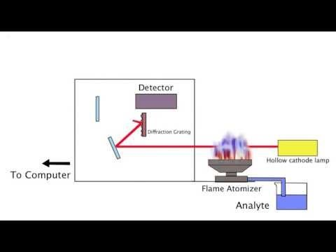

Slide 6
The key points to understanding AAS are that light with specific frequencies are absorbed by different metals when they are vaporised. The energy absorbed excites electrons, moving them from their ground state to a higher energy level. The light is produced by hollow cathode lamps which emit light with specific frequencies, which are absorbed by the vaporised sample. The amount of light absorbed is proportional to the concentration of the metal ion in the sample.
The amount of light absorbed is compared to a calibration curve which is drawn from known concentrations of the metal cation. This analysis can be done manually, but is generally done by the analysis software.

Slide 7
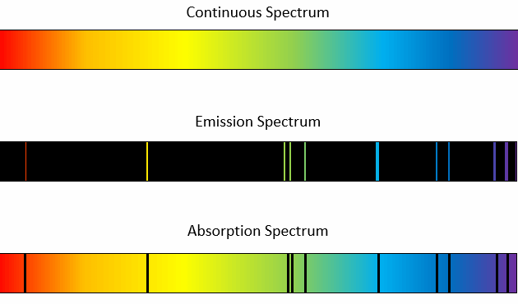
Below is shown a continuous spectrum, the emission spectrum of Helium and the absorption spectrum of Helium.
When looking at elements, note the emission and absorption spectrums are the inverse of each other:

Slide 8

The technique of AAS involves injecting a small sample into the machine. This sample is then vaporised in an atomiser, either using a flame or graphite tube to produce a low density gas of the sample. The cathode tubes are a radiation source, producing light of specific wavelengths. This passes through the sample and then is focused onto a wavelength selector and then detector, where the remaining wavelengths are identified. This signal is amplified and processed to provide an absorption spectrum.
The analyser compares the spectrum with known spectrums to identify the metals present, and the absorbance levels are compared to calibrated values to determine the concentrations.
Below is an absorption spectrum of hydrogen, which forms H⁺ cations

Slide 9
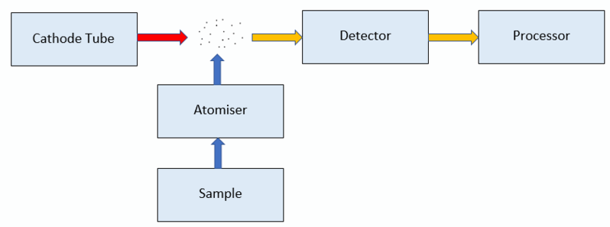
Here is a simplified diagram of the process:

Slide 10
To determine the concentration of an element in solution, the steps are:
1. | Draw a calibration curve using the concentration and absorbance data for a set of standards.
2. | Use the calibration curve and the absorbance of the sample to calculate the concentration of the element in the sample.
3. | If the original sample was diluted before analysis, use the dilution to calculate the original concentration.

Slide 11
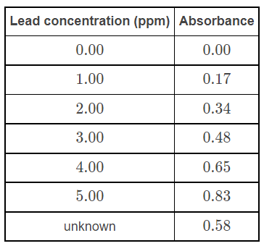
For example, a soil sample was tested for the presence of lead by comparing to absorbance of known concentrations of lead in parts per million (ppm). The data results were:
The soil sample clearly has a concentration between 3.00 and 4.00ppm.

Slide 12
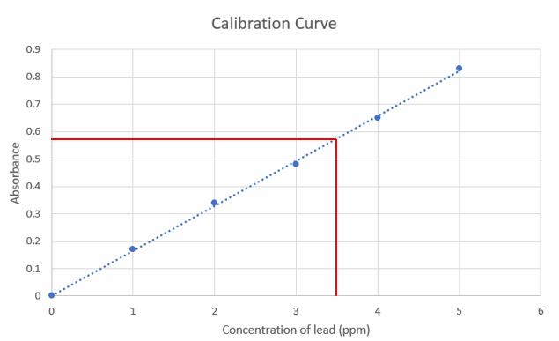
The value can be calculated by drawing a calibration curve, including a line of best fit, then reading off the concentration of lead in the soil sample based on its absorbance:
From the graph it can be seen that a sample with absorbance 0.58 has a lead concentration of 3.50ppm.

